Slide 1

Wits Software Development 2016 Mathematical Sciences Support Group Session 4
By Jason Chalom

Slide 2
The Homework from session 3
See Example

Slide 3
Code
Programming in terms of higher level languages represents a human readable way of constructing mathematical algorithms
Code has mathematical reasoning behind it
Code which describes the same thing may look very different

Slide 4
Clean Code
Part of the AGLIE approach
May different guidelines
Make sure to be consistent
Use proper naming conventions
Styles
Camel case
Pascal case
Self documenting code
Try and avoid comments
Code must be self explanatory
Documentation
Must follow a convention
Be directed at the appropriate target audience

Slide 5
Clean code
Code which is easier to read and understand is
Easier to debug
Come back to
Work with others
Hand off to other teams is easier

Slide 6
Code Patterns
Reusable ‘template’ of code which is a common way of solving a certain technical problem in code
Usually seen as best practise – the proven way of doing something
Reusable
Readable
Some patterns don’t relate to JavaScript but JavaScript is able to simulate them
A good resource:
https://addyosmani.com/resources/essentialjsdesignpatterns/book/#whatisapattern

Slide 7
Code Cohesion
Modularisation of code
Measure of the internal strength of the module
Relationship of code statements within a module
Higher cohesion is better
Can tell you if you should break up a module or not
Understanding what a method does

Slide 8
Cohesion Levels
Cohesion Level | Cohesion Amount | Module Strength
Coincidental | Low Cohesion | Weakest
Logical
Temporal
Procedural
Communicational
Sequential
Functional | High Cohesion | Strongest
Yourdon and Constantine (1979)

Slide 9
Coincidental
The method in question has code lines which are not related.
No meaningful relationship between statements
Difficult to define purpose of statement
See Example

Slide 10
Logical
Statements grouped together
General category
Do similar tasks
i.e. counting different thing etc…
See Example

Slide 11
Temporal
Statements are grouped together because they occur at a similar time
See Example

Slide 12
Procedural
Statements must be executed in a specific sequence or procedure so that specific objectives are achieved
Like an equation
See Example

Slide 13
Communicational
Statements are grouped together because they operate on the same set of data
Seen a lot in CRUD (Create, Read, Update, Delete)
See Example

Slide 14
Sequential
Statements in a method depend on previous statements haven been run
See Example

Slide 15
Functional
All the statements in a method contribute to one specific task
See Example

Slide 16
Coupling
Rather than code it is the data handling of modules or methods
Module independence is desired
Modules are connected by data links (interfaces or couples)
Where is the data coming from?
Understanding what the data is and how it looks
More modern ideas are for more loosely coupled “black boxes”
Modules should not know or care about the internal structures of other modules.
Both coupling and cohesion important today even with higher abstraction layers

Slide 17
Coupling Levels – Old School Ideas
Coupling Level | Coupling Amount | Design Quality
Common | Tight Coupling | Poorest
External
Control
Stamp
Data | Loose Coupling | Best
Myers (1978)

Slide 18
Common
More than one method
Both can see same global data structure
Any method can access and write to the data
Tight coupling => quite bad design
See example

Slide 19
External
More than one method
Both can see same global data variable or primitive structure
Any method can access and write to the data
Less Tight coupling => quite bad design
Similar to common
See example

Slide 20
Control
More than one method
Methods have flags, switches or conditional logic gates which affect another module's logic via a parameter
One variable is sent through which controls further logic flow
See example

Slide 21
Stamp
More than one method
A method passes through a non-global data structure to another method via a parameter
Similar to control coupling
See example

Slide 22
data
More than one method
A method passes through a non-global data variable to another method via a parameter
Similar to Stamp coupling
See example

Slide 23
Implicit Typing
An explicit type like string or int is not used but rather var is used
The type of those variables is determined from what values are sent into the variable
Lots of restrictions
Some don’t recommend it
https://msdn.microsoft.com/en-us/library/bb384061.aspx
See example

Slide 24
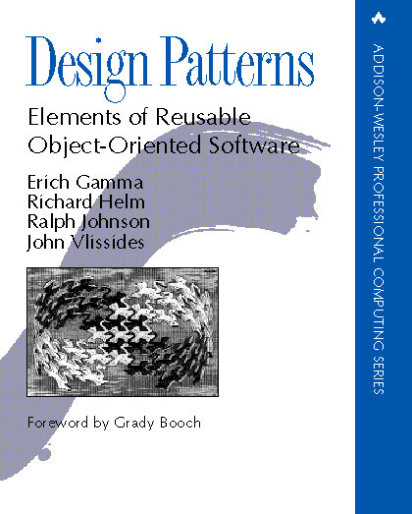
Gang Of Four
Erich Gamma
Richard Helm
Ralph Johnson
John Vlissides

Slide 25
Singleton
A object which only has one instance declared
There is a global access point to it
Used when dealing with error logging in some kind of application
Example:
http://www.dofactory.com/net/singleton-design-pattern

Slide 26
Factory Method
Used often
Creational pattern
Defines an interface for creating generic objects
Lets sub-objects decide which object to instantiate
The factory is an intermediary that allows an object instance to be instantiated with different objects from the same entry point.
Example
See pattern book

Slide 27
Read the book
https://addyosmani.com/resources/essentialjsdesignpatterns/book/

Slide 28
Async VS Sync
Synchronous
Asynchronous
R1
R1
R2
R2
Client
Server
Client
Server

Slide 29
Callback sytax
Based on the programming paradigm of functional programming
Functions are objects
What happens is that a function returns a callback object which can be a data packet or a function.
The find using mongoose from last session is an example of using callbacks to get data objects.

Slide 30
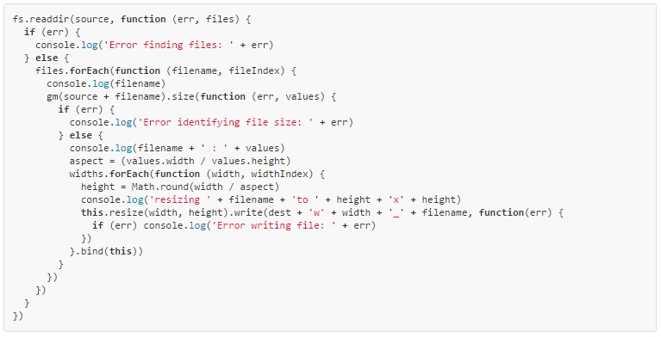
Callback Hell
http://callbackhell.com/

Slide 31
Async Library
https://www.npmjs.com/package/async
http://caolan.github.io/async/
Works with callbacks, but ensures that there is no nesting by using functional style
Utility module with several functions to deal with asynchronous JavaScript
Only looking at async.waterfall
Works like a waterfall, waits for one async function to get data before taking that data and pushing it into the next function on the list

Slide 32
Generators
JavaScript ES5, ES6, ES7 are standards which are loosely followed by NodeJS and web-browsers.
ES6 uses generators, ES7 adds some function directives which aligns with C#.
Generators use a control flow library.
We will look at co
https://www.npmjs.com/package/co
http://benmccormick.org/2015/09/14/es5-es6-es2016-es-next-whats-going-on-with-javascript-versioning/

Slide 33
Promises
It is a placeholder for an eventual result of an asynchronous operation.
i.e. it is a promise of an object
https://spring.io/understanding/javascript-promises

Slide 34
Co library
https://www.npmjs.com/package/co
Two parts
The async function and its promise
The function call – it is wrapped up with the co library
Uses the yield keyword (directive)

Slide 35
The future
ES7
Using the directives
async
await
https://github.com/tc39/ecmascript-asyncawait
Similar to how C# works with asynchronous functions
Detailed Explanation:
http://stackabuse.com/node-js-async-await-in-es7/

Slide 36
The Course Project
For this project, you will be building a simple web interface which can scan selected folders for media and store that information in a database
This week take last weeks work and implement a simple expressJS application which accepts user input for a folder and then stores the results in a database.
Then if the user clicks on the data page of the website display the information in the database
Some Links
https://www.npmjs.com/package/readline-sync
http://stackoverflow.com/questions/2727167/getting-all-filenames-in-a-directory-with-node-js

Slide 37
So Long and Thanks For All The Fish!
And Free stuff for students (Just remember to add your student emails to your accounts on each site)
Jetbrains https://www.jetbrains.com/student/
GitHub https://education.github.com/discount_requests/new
You can find me at: https://jasonchalom.com
Email me at: contact@jasonchalom.com
Have the subject line: SoftDev2016 “what your subject is”

